Slide 1



Paterson Public Schools
Department of Accountability
Our Team
Luis Rojas
Annalesa Williams-Barker
Tammy Williams
Nieara Brownlee
Raquel Ove
Contact us:
accountability@paterson.k12.nj.us

Slide 2
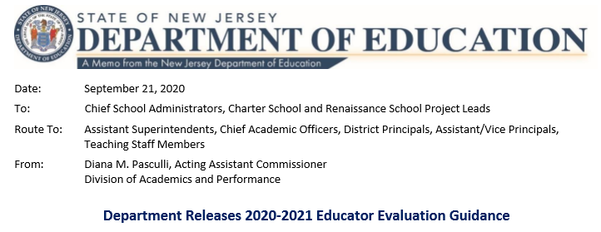

Summary: Educator Evaluation Guidance for School Year 2020-2021

Slide 3
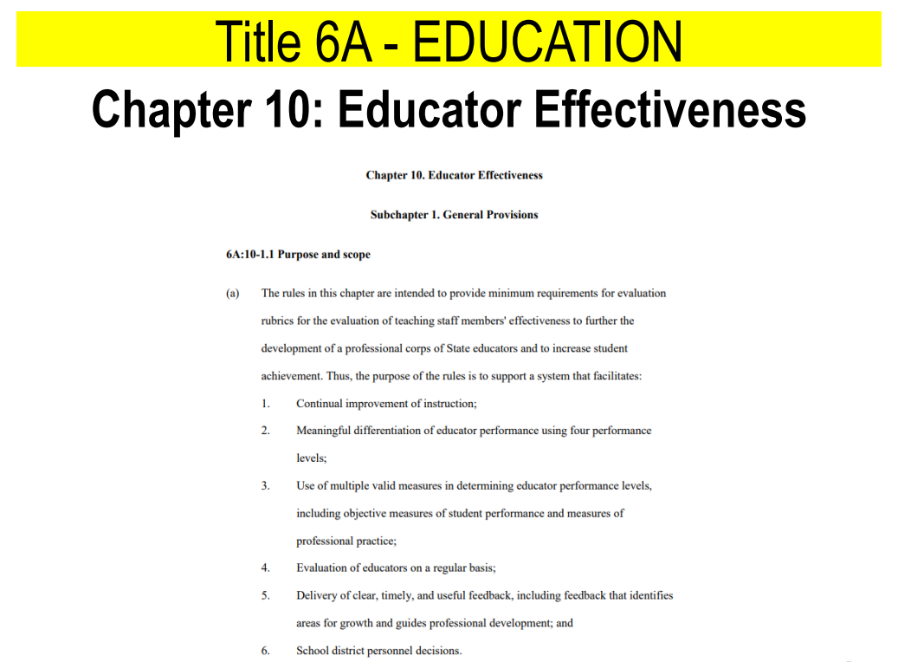

What are the expectations for the evaluation process?
Title 6A-Education Chapter 10 Educator Effective is still in place as it is the law.
TEACHNJ Act, signed into law in August 2012
The TEACHNJ Act links the earning and keeping of tenure to the results of a teacher or principal's annual summative evaluation.
District data-driven decision making

Slide 4


What are methods of collecting data on teacher performance?
WORKING DEFINITION:
Observations are defined as “a method of collecting data on the performance
of a teaching staff member's assigned duties and responsibilities.”
(N.J.A.C. 6A:10-1.2)
A. Traditional in-class observations:
Traditional in-class observations remain the required method for evaluating in-class, in-person instruction. This includes hybrid models in which teachers are teaching in-class, in-person with students.
B. The Portfolio Process:
If instruction is not occurring in-class or in-person, the portfolio process may be utilized for teachers. The collection of evidence should follow the protocols established last spring.

Slide 5
How do we implement the evaluation expectations for 2020-2021 School Year?
If we were present and conducting classes in-person, we would conduct observations as a standalone process
We are NOT presently using standalone observations as a form of collecting data
A. Traditional in-class observations:
Traditional in-class observations remain the required method for evaluating in-class, in-person instruction. This includes hybrid models in which teachers are teaching in-class, in-person with students.
Note: The District is presently in a remote learning environment. See District notifications for updates.

Slide 6
How do we implement the evaluation expectations for 2020-2021 School Year?
As the District is presently in a remote learning environment based on our present national and local health concerns, we are utilizing the PORTFOLIO PROCESS.
This Portfolio Process was utilized last spring.
The Portfolio Process supported non-tenured and/or provisional staff members to earn a rated year.
Attaining a rated year helps the District in its decision-making process
B. The Portfolio Process:
If instruction is not occurring in-class or in-person, the portfolio process may be utilized for teachers. The collection of evidence should follow the protocols established last spring.
Note: The District is presently in a remote learning environment. See District notifications for updates.

Slide 7
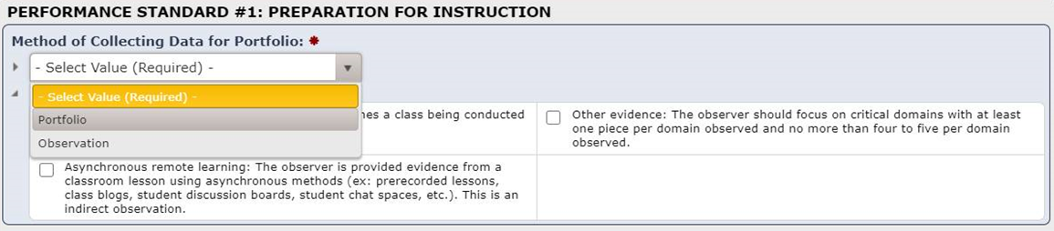
Media X View
PORTFOLIO
Reminder: The Portfolio Observation Process is based of the Professional Educator Standards that have been in place.

Slide 8
What are the guidelines for the portfolio process for 2020-2021 School Year?
1. Traditional twenty-minute single classroom observation with an equivalent method
Has the value of what we understand to be a typical/standard observation (whether 20 minutes/short or 40 minutes/long)
2. Allows educators to showcase their professional practice with a set of artifacts, stretched out over a window of time (defined as a period of two to three weeks up to two months)
The use of artifacts has always been a part of the post conference process.
The use of artifacts will continue to be part of the post conference process. It is even more critical, as it is a required component of the portfolio process, as it was in Spring of last year.
The administrator must “unhide” the portfolio observation within Media X for the staff member to gain access.
The artifacts are upload into Media X. There is an area for administrators (top portion of Portfolio Observation).
There is an area for staff (bottom portion right above signature).
The Annual Memorandum has been shared on August 26th. This reflects the window of time/round. See Accountability webpage as well.
Note: The District is presently in a remote learning environment. See District notifications for updates.

Slide 9
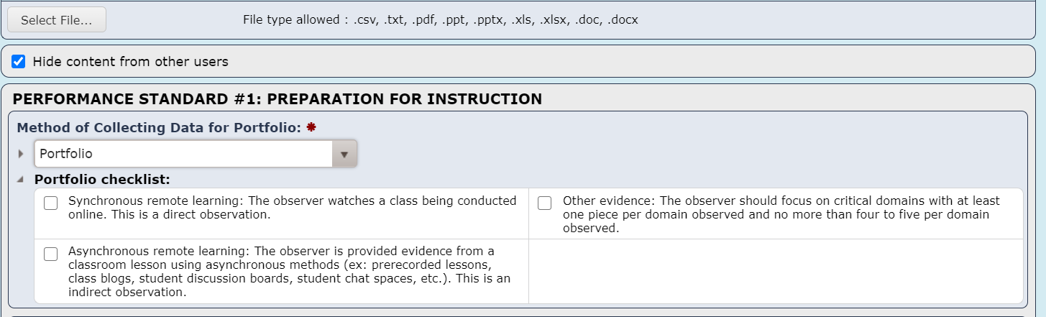
Media X View
UNHIDE
Reminder: The Portfolio Observation Process is based of the Professional Educator Standards that have been in place.

Slide 10
What are the windows for the portfolio process within the 2020-2021 School Year?
3. Observation Window Specifics:
Windows in which evidence will be collected should be mutually agreed upon by the educator and his or her supervisor. See Annual Memorandum (Emailed: 8/26/2020 or Accountability Webpage) to address required timeframe and expected standards to be addressed within a given window.
A window cannot open until after the previous observation window has closed. This is in alignment with our District guidelines. Another observation should not be completed until the initial observation has been completed along with the post conference. Each school and department Evaluation Dashboard is available for review and missing/required information.
If the portfolio observation includes a preconference, this must occur within seven working days prior to opening the observation window. This is in alignment with our District guidelines. Preconference forms are found within Media X for completion. We want to ensure all the standard guidelines in the Teacher/Administrator Guidebooks (see Accountability webpage) are followed.
All post conferences must occur within 15 (10 days for District expectations) working days of the close of the observation window. This is in alignment with our District guidelines. Provide at least 24-hour notice to staff member of the review.
Note: The District is presently in a remote learning environment. See District notifications for updates.

Slide 11
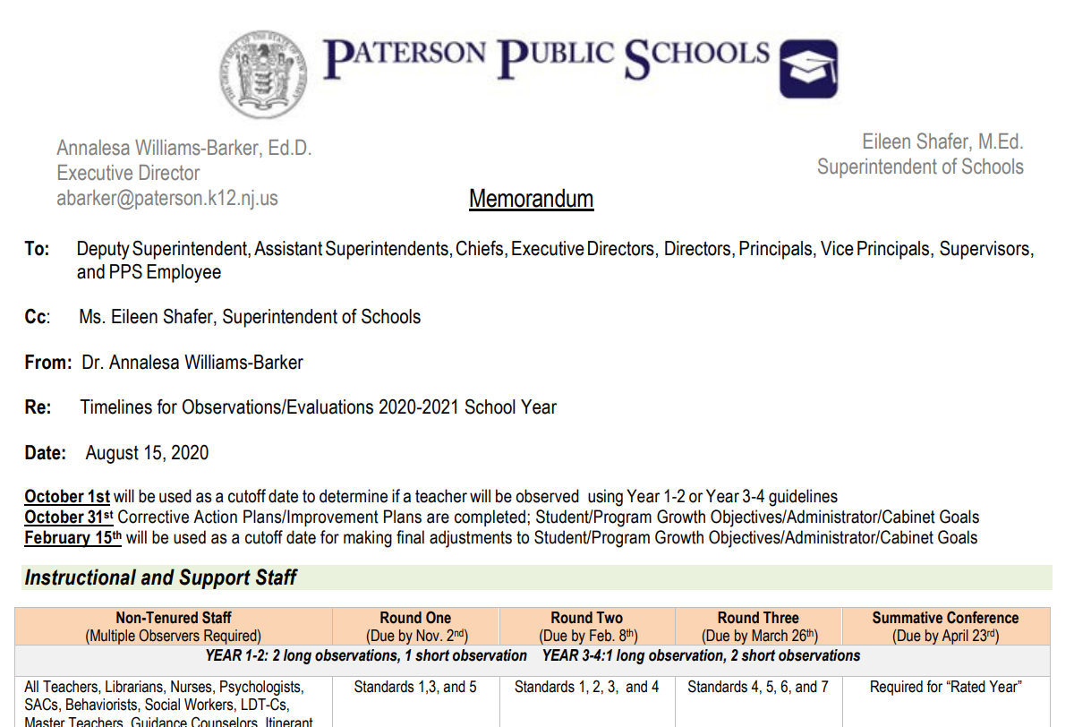
What are the windows for the portfolio process within the 2020-2021 School Year?
Timelines
for Observations/Evaluations
2020-2021 School Year
(Annual Evaluation Memorandum)

Slide 12
What are the specific evidence for the portfolio process for 2020-2021 School Year?
4. Portfolio Evidence Specifics:
a. Educators gather artifacts of their work completed during the observation window which are aligned to the observation instrument’s domains and indicators. See Annual Memorandum (Emailed: 8/26/2020 or Accountability Webpage) to address required timeframe and expected standards to be addressed within a given window.
This is not meant to be a large portfolio.
The artifacts are upload into Media X.
There is an area for administrators (top portion of Portfolio Observation).
There is an area for staff (bottom portion right above signature).
The artifact is included in the rating/scoring with the designated standard for the given time/round
Note: The District is presently in a remote learning environment. See District notifications for updates.

Slide 13
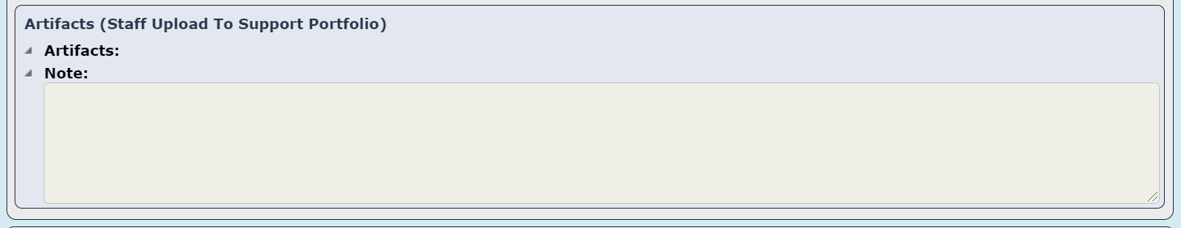
Media X View
ARTIFACTS
Reminder: The Portfolio Observation Process is based of the Professional Educator Standards that have been in place.

Slide 14
What are the specific evidence for the portfolio process for 2020-2021 School Year?
4.Portfolio Evidence Specifics (continued):
Both the supervisor and teacher must agree on the type of learning that will be included in the portfolio. Included should be evidence of direct observation of synchronous OR the indirect observation of asynchronous online learning:
Synchronous remote learning: The observer watches a class being conducted online. This is a direct observation.
Within real-time
Within the staff member/student schedule (Infinite Campus)
Announced
Unannounced
Long (40 minutes or class period)
Short (20 minutes)
Requires post conference to review both the artifacts and provide feedback on the direct observation (Apply Signatures)
See Annual Memorandum and Teacher/Administrator Guidebook
Note: The District is presently in a remote learning environment. See District notifications for updates.

Slide 15
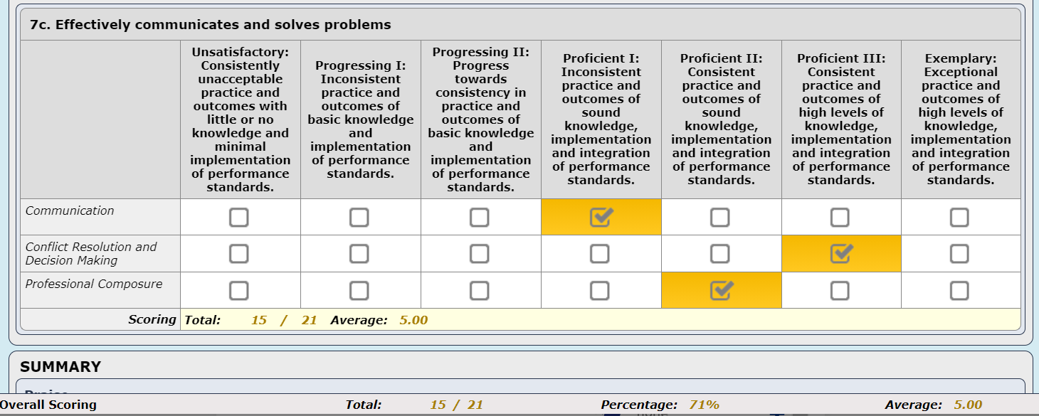
Media X View
SCORING
Reminder: The Portfolio Observation Process is based of the Professional Educator Standards that have been in place.

Slide 16
What are the specific evidence for the portfolio process for 2020-2021 School Year?
4.Portfolio Evidence Specifics(continued):
b. Both the supervisor and teacher must agree on the type of learning that will be included in the portfolio. Included should be evidence of direct observation of synchronous OR the indirect observation of asynchronous online learning:
Asynchronous remote learning: The observer is provided evidence from a classroom lesson using asynchronous methods (ex: prerecorded lessons, class blogs, student discussion boards, student chat spaces, etc.). This is an indirect observation.
Authentic work/artifact of the respective staff member
Included within the timeframe/round; highly recommended there is the inclusion of date/brief description
Requires post conference to review both the artifacts and provide feedback on the indirect observation(Apply Signatures)
See Annual Memorandum and Teacher/Administrator Guidebook
Reminder: The Portfolio Observation Process is based of the Professional Educator Standards that have been in place.

Slide 17
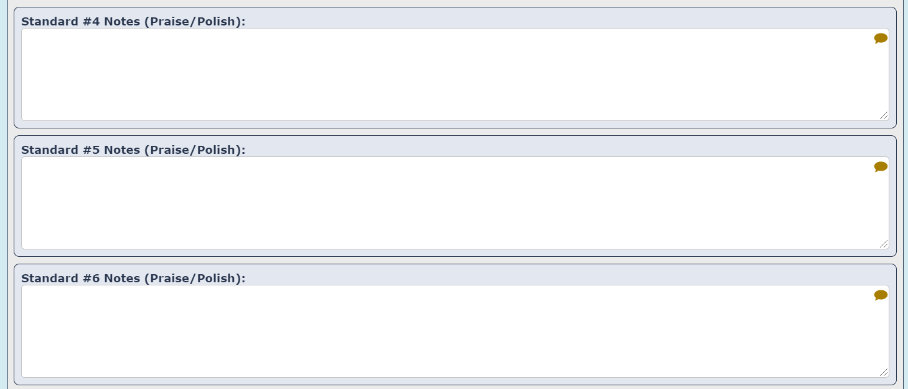
Media X View
FEEDBACK
Reminder: The Portfolio Observation Process is based of the Professional Educator Standards that have been in place.

Slide 18
What are the specific evidence for the portfolio process for 2020-2021 School Year?
4.Portfolio Evidence Specifics(continued):
b. Both the supervisor and teacher must agree on the type of learning that will be included in the portfolio. Included should be evidence of direct observation of synchronous OR the indirect observation of asynchronous online learning:
Other evidence should focus on critical domains with at least one piece per domain observed and no more than four to five per domain observed. This is not intended to be a laborious process. Highly quality evidence is the essential element.
Evidence collected must be relevant to the assigned duties and responsibilities associated with teaching in a remote setting.
Job descriptions are available for reference on the Staff Page
There should be enough evidence presented to facilitate a conversation regarding the educator’s growth during the specified window.
Post conference accompanies each window/round.
Note: The District is presently in a remote learning environment. See District notifications for updates.

Slide 19
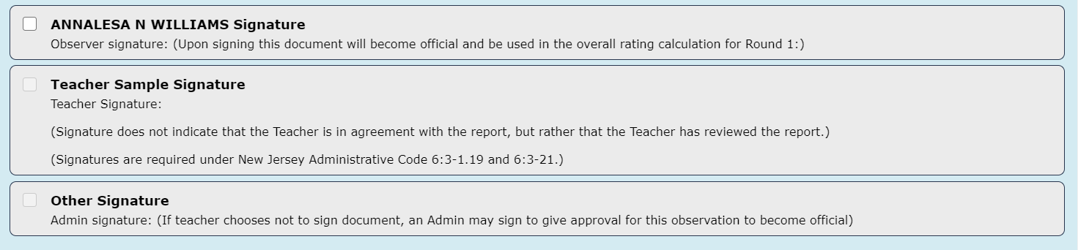
Media X View
SIGNATURE
Reminder: The Portfolio Observation Process is based of the Professional Educator Standards that have been in place.

Slide 20
Rudimentary Practices
5. Other Important Information:
All conferences can be conducted via teleconferencing.
Pre-conferences and post-conferences are all held via teleconferencing within the designated timeframes establish in Teacher/Administrator Guidebooks
Prior to beginning these observations, it is recommended that you consult your district’s DEAC or other stakeholder committee to discuss the New Jersey Department of Education’s (NJDOE) recommendations and the district’s procedures.
Use the District guidebooks as a reference and the forms found within Media X
All practice instruments score evaluations differently and districts have local flexibility in the weighting and scoring.
The District is using the Focal Point Evaluation instruments as delineated in our guidebooks and Accountability webpage
Districts should consider the approach currently in place to ensure evaluation procedures will result in a fair and equitable score under the amended circumstances.
The District has provided guidelines in alignment with NJDOE and has actively maintained its DEAC to support staff members through the evaluation process
Link https://www.nj.gov/education/covid19/teacherresources/edevaluation.shtml

Slide 21

…for your diligence, patience, and grit!
Know, we are here to support you!
We will get to evaluation finish line!
accountability@paterson.k12.nj.us
YOU
ROCK!!

